Slide 1
Image classification
tooYoungTooSimple
Department of Statistics
The University of Georgia

Slide 2
Overview
Introduction
Data Preprocessing
Modeling
Prediction

Slide 3

Introduction
CIFAR-10 image dataset, 10 different labeled categories
60,000 PNG images with 50,000 for training and 10,000 for testing
32 $×$ 32 pixels, 3 color channels: standard RGB format

Slide 4
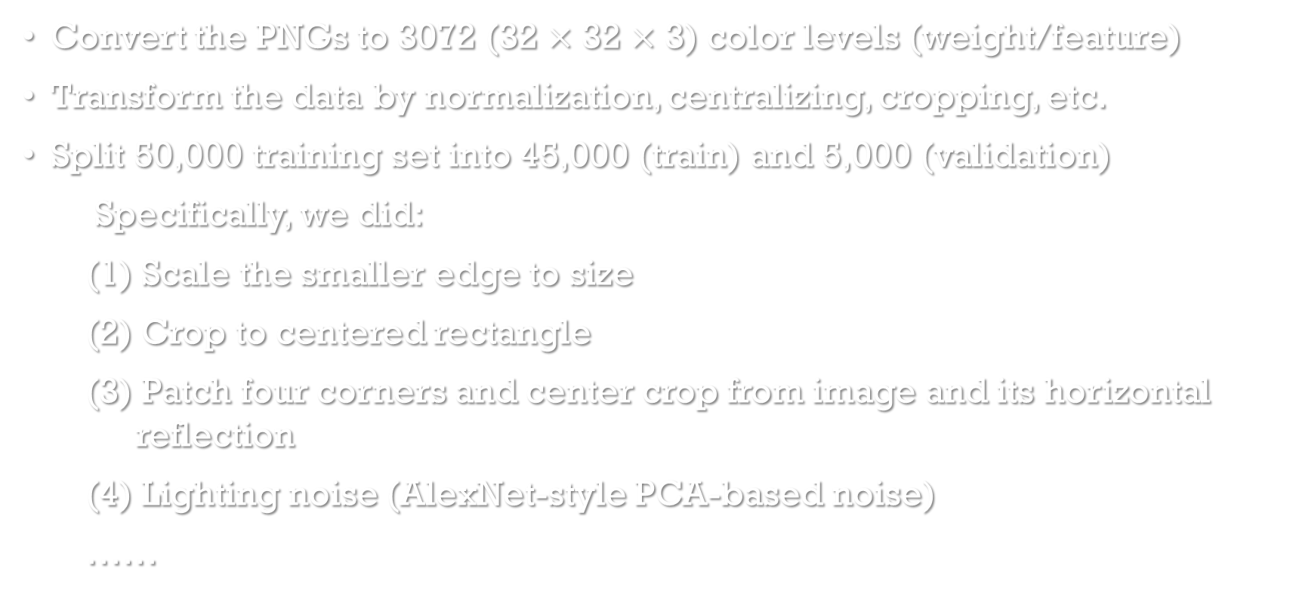
Data Preprocessing
Convert the PNGs to 3072 (32 $×$ 32 $×$ 3) color levels (weight/feature)
Transform the data by normalization, centralizing, cropping, etc.
Split 50,000 training set into 45,000 (train) and 5,000 (validation)
Specifically, we did:
(1) Scale the smaller edge to size
(2) Crop to centered rectangle
(3) Patch four corners and center crop from image and its horizontal reflection
(4) Lighting noise (AlexNet-style PCA-based noise)
……

Slide 5
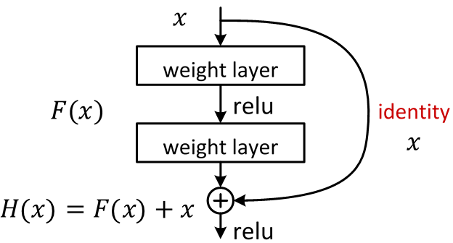
modeling
Residual Neural Network
Referred paper: Deep Residual Learning for Image Recognition, Kaiming He, Xiangyu Zhang, Shaoqing Ren, Jian Sun (2015)
With 119 layers to train, the depth of network is (9n+2), limited by memory
Notes:
About the paper:
This approach is to solve degradation problem, which is when the network depth increases, accuracy gets saturated. It is because additional layers may cause the training error becomes larger.
Solution by construction to the deeper model: the added layers are identity mapping, and the other layers are copied from the learned shallower model.
Deep Residual Learning framework: Instead of fitting a desired underlying mapping directly from each few stacked layers, we explicitly let these layers fit a residual mapping. Denote the desired underlying mapping as H(x), let the stacked nonlinear layers fit another mapping of F(x):= H(x) – x. Then the original mapping becomes F(x) + x. Hypothesize that it is easier to optimize the residual mapping than to optimize the original.
The formulation of F(x) + x can be realized by “shortcut connections”, which is shown to the right. In our case, the shortcut connections simply perform identity mapping, and their outputs are added to the outputs of the stacked layers.

Slide 6
modeling
Final Model parameters has 119 layers, and 250 epoch (GPU and memory limit)
Increasing more layers would marginally improve the model performance
Training error becomes stable after 120 epochs
Notes:
About the paper:
This approach is to solve degradation problem, which is when the network depth increases, accuracy gets saturated. It is because additional layers may cause the training error becomes larger.
Solution by construction to the deeper model: the added layers are identity mapping, and the other layers are copied from the learned shallower model.
Deep Residual Learning framework: Instead of fitting a desired underlying mapping directly from each few stacked layers, we explicitly let these layers fit a residual mapping. Denote the desired underlying mapping as H(x), let the stacked nonlinear layers fit another mapping of F(x):= H(x) – x. Then the original mapping becomes F(x) + x. Hypothesize that it is easier to optimize the residual mapping than to optimize the original.
The formulation of F(x) + x can be realized by “shortcut connections”, which is shown to the right. In our case, the shortcut connections simply perform identity mapping, and their outputs are added to the outputs of the stacked layers.

Slide 7
prediction
Prepare the testing data in the same way as training set
Testing with the model with best performance in validation set
Achieve 92.82% prediction accuracy in the test set on Leaderboard
Notes:
Modify the “Trainer:test()” function in train.lua
Reorder the result by “X_test.txt”, target and result by changeResultOrder.py

Slide 8
Q & a

